Slide 1
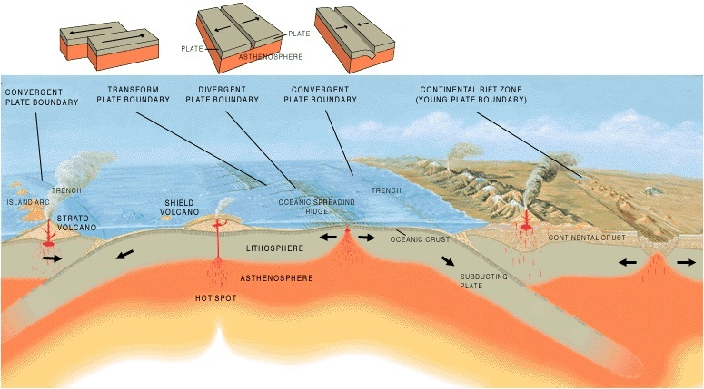
Daily Review
Earth’s lithosphere is divided into tectonic plates.
Due to convection currents in the mantle, these plate are in constant motion.
Tectonic plates can converge, diverge or slide past each other.
Copy the table onto your whiteboard (including the third column).
Fill in the first two columns with information regarding plate boundaries.
Don’t rub it off yet.
Type of plate boundary | Direction of Movement

Slide 2
Daily Review
Interactions between plate boundaries can cause earthquakes and formation of mountain ranges, volcanoes, rift valley, trenches and mid-ocean ridges.
Add a heading to the third column of the table: Features at Plate Boundary.
Use the image to help you fill in the third column of the table.

Slide 3
Earthquakes Year 9 Earth Science

Slide 4
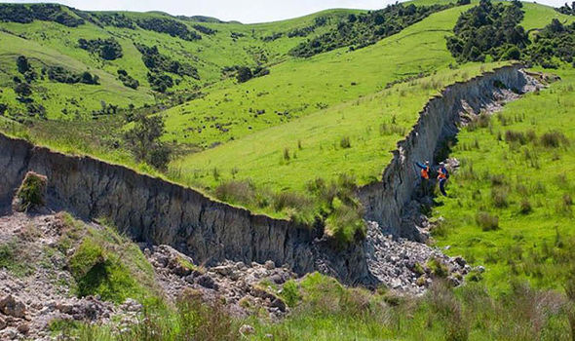
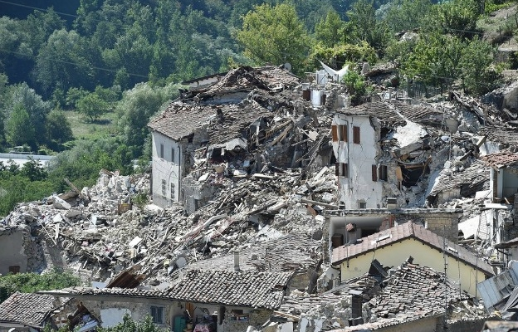
Learning Objective
CFU
What are we going to learn?
Explain how earthquakes are formed.
Define the epicentre and focus of an earthquake.
Explain how scientists measure the size of earthquakes.
Activate Prior Knowledge
Think, Pair, Share: How does an earthquake affect people’s lives?

Slide 5
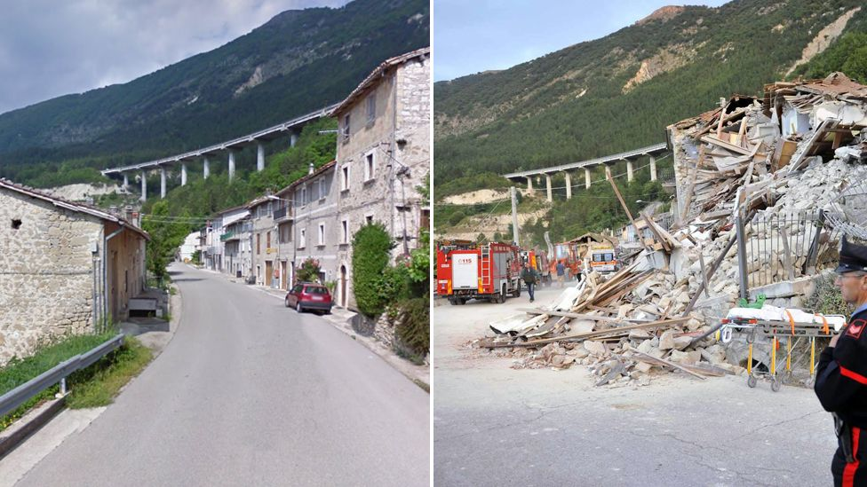
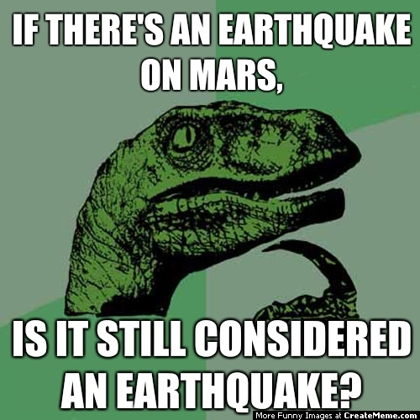
Concept Development
CFU 1
What are Earthquakes? What causes them?
Earthquakes
Earthquakes are sudden movement or shaking of the Earth caused by stress between tectonic plates.
They occur at plate boundaries and result in breakage of the Earth’s brittle crust.
CFU 2
Where do Earthquakes happen ?

Slide 6
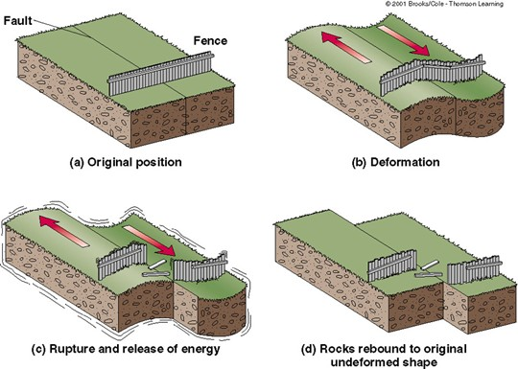
Concept Development
Vocabulary
fault: fracture or group of fractures in a block of rock
CFU 1
Explain the stick - slip motion of tectonic plates.
Plate tectonic stresses
When rock moves at plate boundaries and fault zones, there is friction.
They move in a STICK-SLIP motion; with p periods of no movement (stick) and fast movement (slip)
Energy is stored as plates stick and this energy is released when they slip.
CFU 2
Where does the energy released during an earthquake come from?

Slide 7
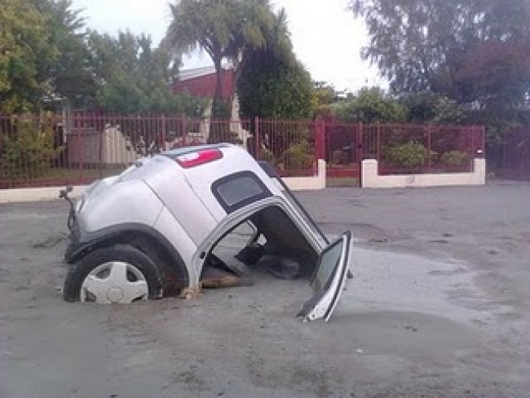
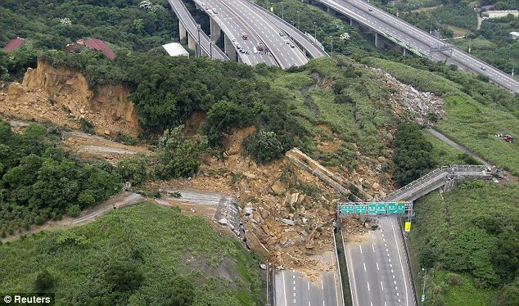
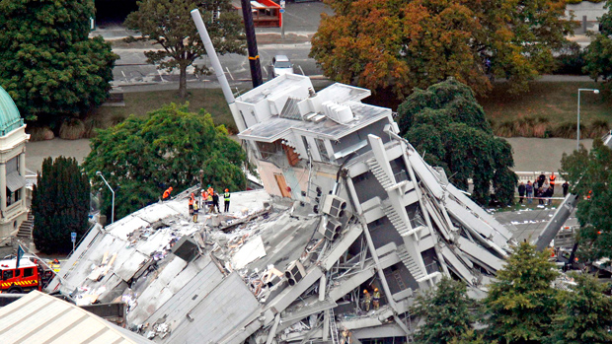
Concept Development
Vocabulary
infrastructure: facilities serving a city eg. powerlines, roads, water pipes
CFU 1
What type of damage is shown in each picture?
Damage Caused by Earthquakes
Land slides
Building and infrastructure damage
Liquefaction - sand and soil becomes saturated with water and acts like a liquid.
CFU 2
Other than building damage, how might an earthquake affect a city?
1
2
3

Slide 8
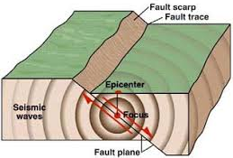
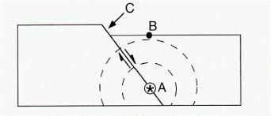
Concept Development
CFU 1
Define the focus of an earthquake?
Anatomy of Earthquakes
The focus of an earthquake is the point within the Earth where the energy is released.
The point where the energy reaches the surface, directly above the focus is called the epicentre.
The waves of energy waves released are called seismic waves.
CFU 2
Where is the epicentre of an earthquake located?
CFU 3
In the diagram on the right, what does each letter represent?
Fault
Epicentre
Focus
Vocabulary
seismic: relating to earthquake or other vibrations in the Earth.

Slide 9
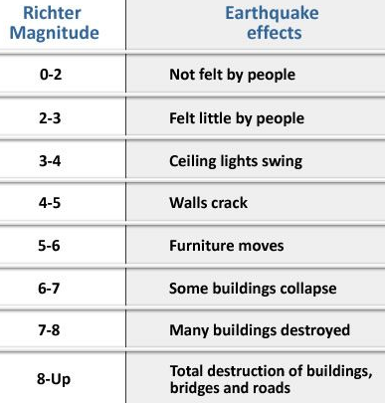
Concept Development
CFU 1
What does a 1 step increase on the Richter scale mean in terms of an earthquake’s size?
Measuring Earthquakes
The magnitude (size) of earthquakes are measured using the Richter scale.
For each step on the scale, the earthquake size increases 10 times.
A magnitude 3 earthquake will be 10 times more powerful than one of magnitude 2.
CFU 2
An earthquake measures 5.2 on the Richter scale. List 3 things that might be seen or felt.
CFU 3
If buildings start to collapse after an earthquake, what is its approximate magnitude on the Richter scale?

Slide 10
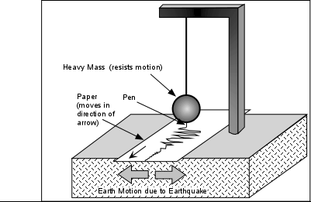
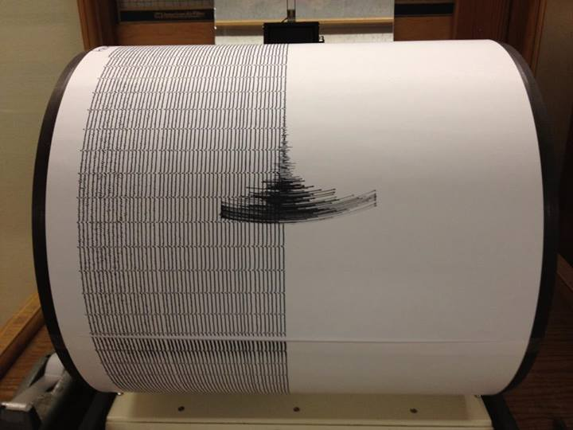
Concept Development
CFU 1
Explain the difference between a seismograph and a seismogram?
Magnitude of earthquakes
Scientists measure the magnitude of earthquakes using an instrument called seismograph.
A record produced by a seismograph is called a seismogram.
Vocabulary
seismic: relating to earthquake or other vibrations in the Earth.

Slide 11
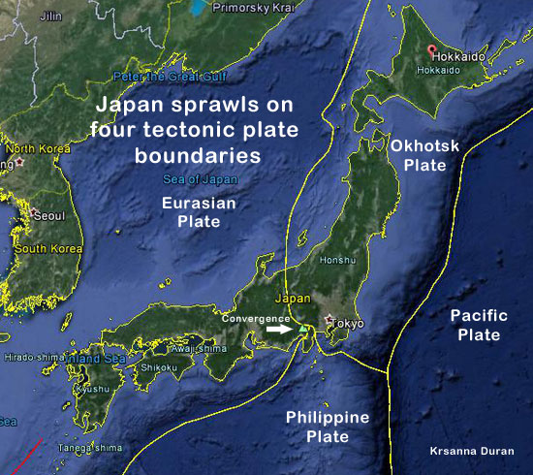
Skill Development/Guided Practice
Japan experiences frequent earthquakes, both small and large.
Using the map to explain why it is an earthquake prone country.
Japan experiences frequent earthquakes because_________________.
Vocabulary
seismic: relating to earthquake or other vibrations in the Earth.

Slide 12
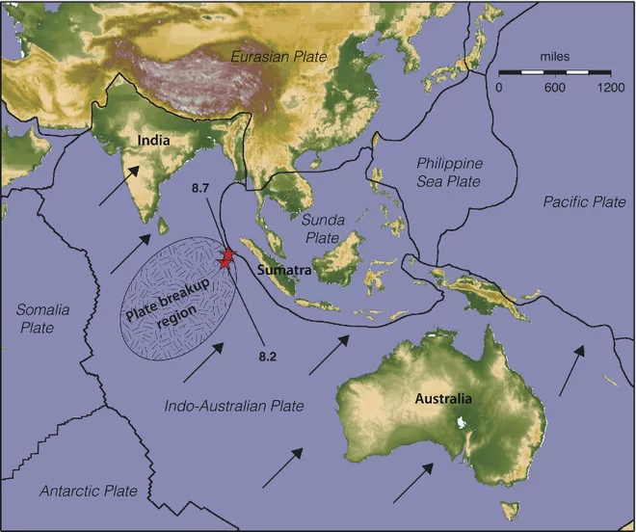
Skill Development/Guided Practice
Earthquake activity is minimal in Australia.
Use the map to explain why.
Australia has minimal earthquake activity because _________________.
Vocabulary
seismic: relating to earthquake or other vibrations in the Earth.

Slide 13
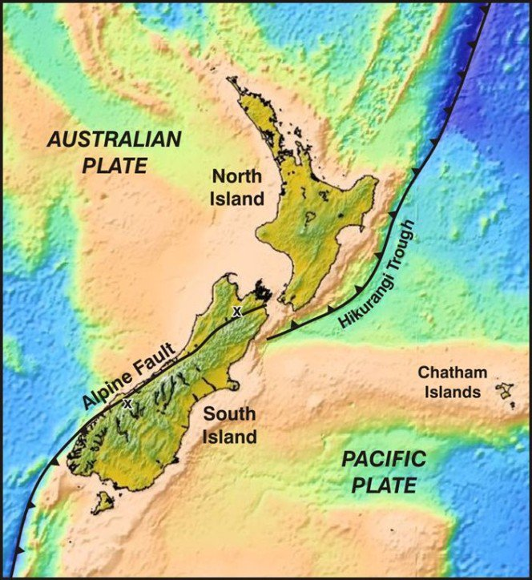
Skill Development/Guided Practice
Would you expect New Zealand to have frequent seismic activity?
Use the map to explain why or why not.
Vocabulary
seismic: relating to earthquake or other vibrations in the Earth.

Slide 14
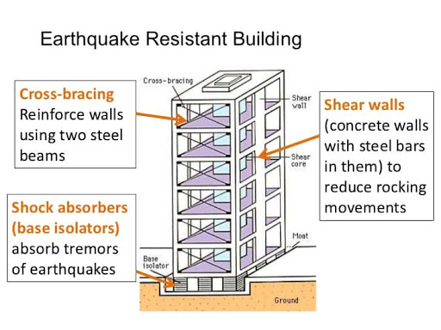
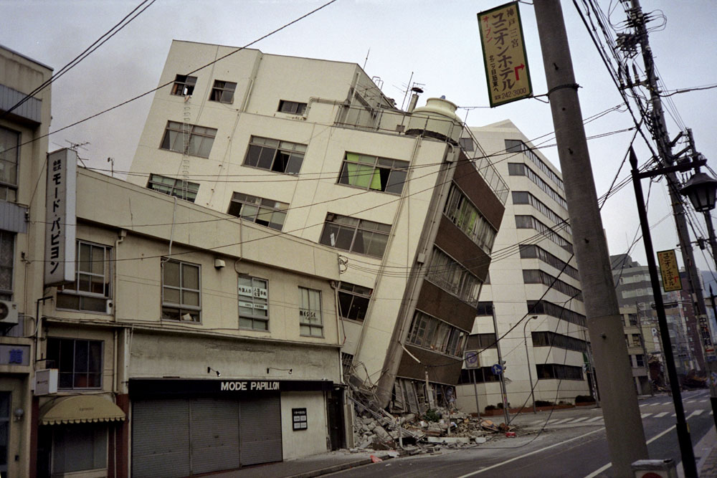
Relevance
Understanding the relationship between tectonic plate movement and earthquakes will help communities prepare for potential earthquakes.
The type of damage caused by earthquakes often depends on the size and the location of the earthquake. Engineers can develop earthquake resistant buildings to minimise the damage caused.

Slide 15
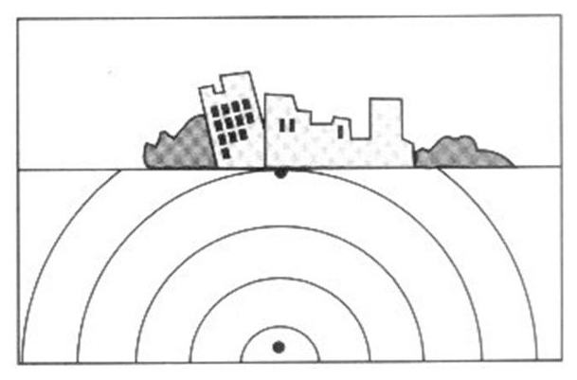
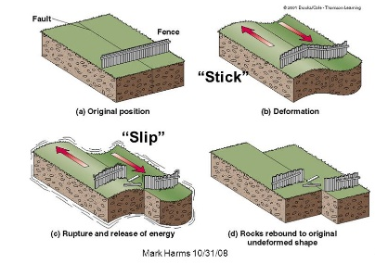
Skill Closure
List three types of destruction caused by an earthquake.
Skill Closure
Explain the difference between the focus and the epicentre of an earthquake.
Skill Closure
Describe how an earthquake occurs through stick-slip motion of tectonic plates and faults.

Slide 16
Independent Practice
Complete the Earthquakes worksheet on your device or a paper copy.

